Slide 1

Detecting Grape Leaf Disease and Classification using Machine Learning
CS5710 Machine Learning - Project
2022 Fall
Team:
1. Vamsi Krishna Mekala 700742751
2. Pavani Katkuri 700732649
3. Mahathi Reddy Panyala 700743307
4. Ranga Jayanth Kumar 700740660

Slide 2
Role/Responsibilities and Contribution in project
Problem description and dataset formation: Images for the dataset are downloaded and then they are preprocessed using the python CV2 library with various image processing techniques and application of grabcut algorithm - Vamsi Krishna Mekala, 700742751 did this task.
Feature Extraction to get the features of the leaf sample and the affected region and implementation of multi SVM - Mahathi Reddy Panyala, 700743307 did this task.
Model training with Random forest and decision tree algorithms with the features extracted in the above step - Pavani Katkuri performed this task.
Creating the model and parameters according to the training data and also fitting the data to the model: Here we created the Bagging algorithm and fitted the preprocessed data to the model. Ranga Jayanth Kumar, 700740660 did this task.

Slide 3
Motivation & Objectives:
Grape is a largely cultivated crop over the world and early detection of such grape leaf diseases yields higher crop production with preventive steps prior.
To build a machine learning application that accurately classifies the given leaf image into it respective diseased version using bagging algorithms.
Applying the Global Thresholding technique to segregate the grape leaves in an image from its background.

Slide 4
Related Work
H. Al-Hiary et al.[2] For the clustering and classification of diseases that impact plant leaves, developed applications of K-means clustering and neural networks. Five plant diseases—early scorch, cottony mold, ashen mold, late scorch, and small whiteness—were used to test their algorithm. Their experimental findings demonstrated the value of their suggested approach, which can considerably aid in the precise diagnosis of leaf diseases with minimal computational work.
Shriroop C. Madiwalar et al.[3] suggested using color photos of mango leaves to identify plant diseases using machine vision. The diagnosis of two illnesses, anthracnose and leaf spot, was made on the leaves after disease identification. For the feature extraction process, the authors used three feature groups: the GLCM feature, the Color-based feature, and the Gabor filter feature. They came to the conclusion that the Gabor filters boundary extraction effectively detected the smaller spots in the case of leaf spot, but the other two techniques are in charge of the denser texture analysis as in the case of anthracnose.
H. Sabrol et al.[4] categorised photographs of healthy tomato plant leaf and stem, Septoria spot, bacterial spot, bacterial canker, tomato leaf curl, and tomato late blight. By separating colour, shape, and texture information from photos of healthy and ill tomato plants, the authors performed categorization. Six different types of tomato photos were categorised, and the overall classification accuracy was 97.3

Slide 5
Problem statement
Grape, which is a widely grown crop globally and it may be affected by different types of diseases on leaf, stem and fruit. Leaf diseases which are the early symptoms caused due to fungi, bacteria and virus. So, there is a need to have an automatic system that can be used to detect the type of diseases and to take appropriate actions prior. We have proposed an automatic system for detecting the diseases in the grape vines using image processing and machine learning techniques. The system segments the leaf from the background image using grabcut segmentation method. From the segmented leaf part the diseased region is further segmented based on two different methods such as global thresholding and using semi supervised technique.

Slide 6
Proposed solution
We have proposed an automated disease detection and classification system for grape leaves using traditional image processing and machine learning techniques. The proposed system first segments the ROI from the background using grabcut algorithm and classify the segmented leaves as healthy, balck-rot, esca and leaf blight. Figure. 1 depicts different types of disease in grape leaves. These diseases are caused due to fungi infection on the leaves. Each disease have different characteristics where black rot appears to be circular in shape and has dark margins, esca appears as dark red stripes and leaf blight appears to be solid reddish-purple spots. The proposed system consists of five different process such as image preprocessing, image segmentation, feature extraction, disease detection and identification.
Dataset: Our dataset is images with 4 different classes. Each image is of size 250x250. We have totally considered 3000 images to train. The folders were Leaf blight, Black rot, Escala, and Healthy leaf. From these images, we created a .csv file with various dimensions of all the taken leaf sample data.

Slide 7
Feature engineering
Support Vector Machine (SVM)
From the info pictures, the highlights are to be extricated. To do as such as opposed to picking the entire arrangement of pixels we can pick just which are fundamental and adequate to portray the entire of the fragment. The fragmented picture is first chosen by manual impedance. The influenced territory of the picture can be found from figuring the zone associating the parts.
In the first place, the associated segments with 6 neighborhood pixels are found. Later the fundamental locale properties of the information twofold picture are found.
The include extraction is utilized to remove the data that can be utilized to discover the hugeness of the given example. The fundamental sorts of highlights are shape, shading and surface, which are for the most part utilized as a part of picture preparing procedure.
SVMs depend on the Structural Risk Minimization (SRM) rule from measurable learning hypothesis. In their essential frame, SVMs endeavor to perform order by building hyper planes in a multidimensional space that isolates the instances of various class marks. It bolsters both arrangement and relapse undertakings and can deal with various persistent and ostensible factors.

Slide 8
Decision Tree
Random Forest
A supervised learning method called a decision tree can be used to solve classification and regression problems. It is a tree structured classifier, where internal nodes stand in for a dataset’s features, branches for the decision-making process, and each leaf node for the classification result.
The given dataset’s features are used to execute the test or make the decisions. It is a graphical depiction for obtaining all feasible answers to a choice or problem based on predetermined conditions.
Popular machine learning algorithm Random Forest is a part of the supervised learning methodology. It can be applied to ML issues involving both classification and regression. It is built on the idea of ensemble learning, which is a method of integrating various classifiers to address difficult issues and enhance model performance.
Random Forest, as the name implies, is a classifier that uses a number of decision trees on different subsets of the provided dataset and averages them to increase the dataset’s predictive accuracy. Higher accuracy and overfitting are prevented by the larger number of trees in the forest.

Slide 9
Adaboost classifier
Bagging Algorithm
A common method for solving binary classification issues is boosting. By transforming a number of weak learners into strong learners, these methods increase prediction ability. The basic idea behind boosting methods is that after creating a model using the training dataset, we create a second model to fix any mistakes in the original one.
To get the final output, the boosting process combines several models. AdaBoost, also known as Adaptive Boosting, is a machine learning method used as an ensemble framework. Decision trees with one level, or Decision trees with only one split, are the most popular algorithm used with AdaBoost.
Bagging, also known as Bootstrap aggregating, is an ensemble learning technique that helps to improve the performance and accuracy of machine learning algorithms. It is used to deal with bias-variance trade-offs and reduces the variance of a prediction model.
Bagging avoids overfitting of data and is used for both regression and classification models, specifically for decision tree algorithms.

Slide 10
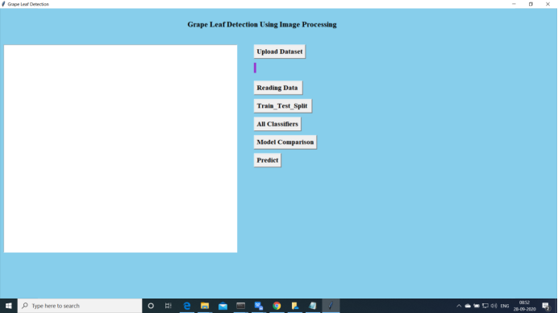
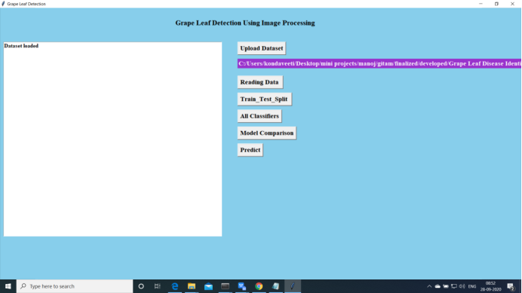
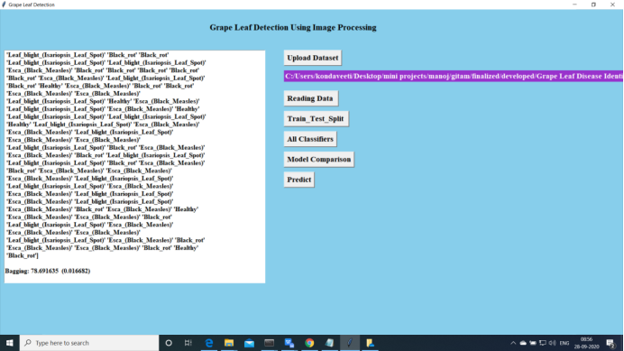
Results & simulation
Opening Screen
2. Uploading the dataset
3. Model training

Slide 11
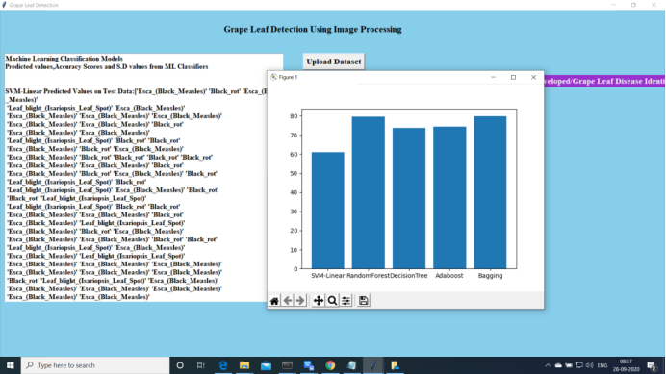
Accuracy metric for the implemented algorithms
The global thresholding strategy, which was utilised to segment the specific sick section of the leaves and improve classification outcomes, was shown to be more appropriate for training the model. The training accuracy results from various machine learning methods are compiled. The results clearly show that when the features are retrieved from the diseased area of the images using global thresholding and trained using an SVM classifier with tuned parameters—SVM performs well when the data is very non-linear—good training accuracy is attained. For 1135 test photos, an overall accuracy of 93.035% was achieved.

Slide 12
References
[1] Abdullah, N. E., Rahim, A. A., Hashim, H., Kamal, M. M. (2007, December). Classification of rubber tree leaf diseases using multilayer perceptron neural network. In 2007 5th student conference on research and development (pp. 1-6). IEEE.
[2] Al-Hiary, H., Bani-Ahmad, S., Reyalat, M., Braik, M., Alrahamneh, Z. (2011). Fast and accurate detection and classification of plant diseases. International Journal of Computer Applications, 17(1), 31-38.
[3] Madiwalar, S. C., Wyawahare, M. V. (2017, February). Plant disease identification: a comparative study. In 2017 International Conference n Data Management, Analytics and Innovation (ICDMAI) (pp.13-18). IEEE.
[4] Sabrol, H., Satish, K. (2016, April). Tomato plant disease classification in digital images using classification tree. In 2016 International Conference on Communication and Signal Processing (ICCSP) (pp. 1242- 1246). IEEE.
[5] Bhange, M., Hingoliwala, H. A. (2015). Smart farming: Pomegranate disease detection using image pre processing. Procedia computer science, 58, 280-288.

